Slide 1

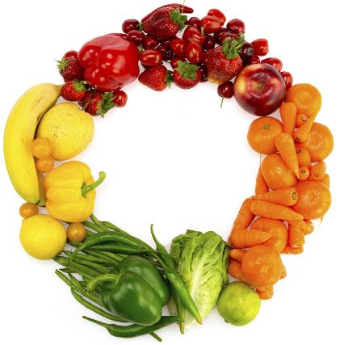


Understanding the US Market for Agro-foods
Deloitte Consulting LLP
December 15, 2021
Stewart Pierce-Gardner

Slide 2


About the Presenters |
Introduction
  Stewart Pierce-Gardner
  Manager
  Trade Specialist
  Office: Washington D.C.
  Email: spiercegardner@deloitte.com
  RELEVANT EXPERIENCE
  Stewart has thirteen years of professional experience in international economic development. His technical experience covers export promotion & value chains. He has managed various projects for USAID, the United Nations, and World Bank Group across the world. He holds a bachelor’s degree in international political economy from Davidson College and a master’s degree of public policy from Georgetown University.
2

Slide 3

Agenda
Introduction, Scope, and Objectives
Market Overview
COVID Impact
Exporting to the US
Questions and Discussion

Slide 4

Introduction, Scope, and Objectives
4

Slide 5
Scope of this Webinar…
Introduction
IS
An overview of the US market for agro-foods with recent trends and consumer preferences impacting demand for domestic and international agro-foods
Targeted summary of market trends, segments, and factors for select products relevant to Sri Lanka
Aligned with NCE recommendations with a focus on coconut products, spices, tea, nuts, and processed foods such as canned food products (for example, jams, chutneys) and confectionaries (for example, biscuits)
An informational framework to guide Sri Lankan food producers and processors in navigating the complexity of the US agro-food market
IS NOT
A complete, detailed market analysis for each type of commodity or food product exported to the US
A comprehensive, one size fits all guide to the imports process
5

Slide 6
Challenges and Objectives
Introduction
  Challenges
  Objectives
Support agro-foods to become a more prominent export sector for Sri Lanka
Gain access to market information and market intelligence
Adapt as needed to technology and supply chain enhancements
Ensure quality control and food safety compliance with accepted global standards
Understand the US market for agro-foods
Describe recent market trends, consumer preferences and segments for various foods/commodities
Explore the most relevant buyers and competitors in the US
Know how to find the resources for trade regulations, customs, and standards for exporting
6

Slide 7
Market Overview
7

Slide 8
Marketscape of Food Imports to the US
MARKET OVERVIEW
Statistics
US consumers expect
Impact
Leading to...
The United States imports…
15% of its overall food supply (~$141B)
From more than 200 countries or territories
From approximately 125,000 exporting food facilities and farms
Resulting in 15 million shipments of imported food in 2021
Variety
Food Safety
Quality
Convenience
Availability
Affordability
Increased volume of imported foods
Increased globalization of the food supply
Potential for increase in economic fraud and intentional adulteration
Many different international food safety standards and regulatory capacities
Potential for new hazards or known hazards in different foods
More complex food chains
Technological advances
Varying business models
Increased specialization
Increased collaboration
Source: USDA ERS - U.S. Food Imports
8

Slide 9
US Agro-food Market Overview
MARKET OVERVIEW
Market Size & Growth
Segments & Competition
Trends & Opportunities
$1.69T food spending in 2020
  84% by U.S. consumers, 9% businesses, and 7% government entities (2020)
  $876.8B (52%) in food-at-home (2020)
  $813.4B (48%) in food-away-from-home (2020)
3.1% estimated YoY growth
24.3% of domestic value accrues to food producers and processors
$141B in agricultural imports (2020)
  68% are horticultural or tropical products
  97% are consumer-oriented products, of which:
    $78B processed
    $14B in semi-processed
    $36B raw
Largest ag. exporters to the US:
  Canada - $22.2B (2015)
  Mexico - $19.3B (2015)
  EU - $18.9B (2015)
Trends
10.1% decline in disposable income spent on total food from 9.6% in 2019 to 8.6% in 2020
More consumers may be buying more food and cooking more at home than they did before the pandemic
Accelerated growing demand for fresh, healthy, additive-free food with traceable origins
Opportunities
Record-level food import values in Q3 of FY 2021 due to pent-up demand from pandemic shutdowns
Source: USDA ERS - U.S. Food Imports
9

Slide 10
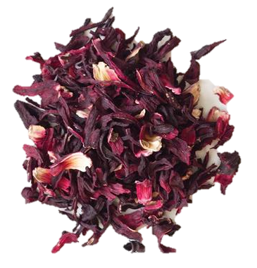
Tea Products
MARKET overview
Market size & growth
Segments & Competition
Trends & Opportunities
$2.8B (2020) to $3.6B (2026) at 4.8% compound annual growth rate (CAGR)
$473.8M (2020) imported
Black Tea is largest segment (56%), while Green Tea is fastest growing segment (8.8% CAGR)
85% consumed cold or iced
Market is highly fragmented with top companies controlling 39% market share (Unilever, RC Bigelow, Traditional Medicinals, Yogi Tea, and Private Label)
Top US import partners: Argentina, Canada, China, India, Vietnam, and Sri Lanka
Trends
Significant on-trade volume decline due to COVID-19 in 2020
Shift in consumer preferences from soda to healthier alternatives of caffeinated beverages like tea and coffee
Opportunities
Expand product portfolio to different types of organic tea, blended leaves products, green tea, and fruit tea
Rise in awareness of health benefits of tea
Billions
Source: Allied Market Research. Global Tea Market
Opportunity Analysis and Industry Forecast, 2019-2026; U.S. tea market - statistics & facts
10

Slide 11

Spices, Sauces, and Condiments Products
MARKET overview
Market size & growth
Segments & Competition
Trends & Opportunities
$27.5B (2020) to $33B (2024) at 4.5% CAGR
Herbs and Spices have the highest CAGR of 6.74%
Other includes stock cubes, gravy granules and liquid stocks, fonds, sweet pickles, pastes and purees, chutneys, and relishes
Market is highly fragmented with top companies controlling 34% market share (Kraft Heinz, McCormick, Campbells, Unilever, and PepsiCo)
$1.2B (2018) imports from 8 countries: Canada, Mexico, Italy, Thailand, China, Japan, Hong Kong, China
Trends
Gaining popularity of ethnic sauces, condiments, and dressing
Rise in sauces and condiments made from natural ingredients that are free from additives
Manufacturers are continually investing in R&D of new flavors and combinations
Opportunities
Incorporation of specialty and gourmet ingredients enable new entrants but established players have strong holds on distribution networks
Billions
Source: Mordor Intelligence. US Spices, Sauces, and Condiments Market (2019-2024)
11

Slide 12
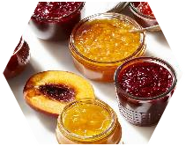
Jam, Jelly, and Preserve Products
MARKET overview
Market size & growth
Segments & Competition
Trends & Opportunities
$885m (2017) to $813m (2022) at -1.7% CAGR
$11.4m import market (2018)
54% market share for jam, with grape and berry flavors dominant
Mature market with 38% of market share held by JM Smucker’s and National Grape Cooperative (Welch’s) brands
Top US import partners: Chile, Spain, Colombia, Costa Rica, and Canada
Trends
Green label, ethical claims, fair trades, convenience and health credentials
High growth in high fruit content, vegetarian spreads, and antibacterial honey
Natural/organic jam, jelly, and preserves are becoming increasingly prominent products
Opportunities
Upward demand for gourmet varieties
Shift to increasingly exotic and savory flavor profiles like tropical fruits and nut purees
Millions
Source: Mordor Intelligence. United States Jam Jelly, Preserve and Packaging Market (2017 – 2022)
12

Slide 13
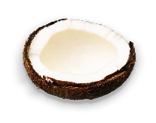
Coconut Products
MARKET overview
Market size & growth
Segments & Competition
Trends & Opportunities
$1.5B (2020) to $3B (2026) at 12% CAGR
76% market share for coconut oil and water
Coconut water is the fastest growing segment at 22% CAGR
$847m cosmetics segment with steady growth share
Top buyers include Barry Callebaut, Nestlé, Unilever and Cargill with 28% market share
Top 5 coconut producers: Indonesia, Philippines, India, Sri Lanka, and Brazil
Trends
Increased food & beverage applications
Rise in coconut water consumption as natural sports drinks
Surge in coconut oil and milk applications in cosmetics
Steady supply relative to increasing demand
Opportunities
Increased number of consumers allergic to dairy products substituting coconut milk
Innovation in taste and flavor of coconut products and coconut-based food & beverages
Billions
Source: Coconut Products Market Global Opportunity
Analysis and Industry Forecast, 2019-2026

Slide 14

Tree and Ground Nuts Products
MARKET overview
Market size & growth
Segments & Competition
Trends & Opportunities
$7.6B (2020) to $8.4B (2025) at 2% CAGR
$923m (2020) import market; 61% from Mexico
Almonds is fastest growing (4%); peanuts and cashews are slowest (2%)
US imported 11% of world’s total cashews in 2019
80% sold off-trade with 57% in supermarkets
Significant market share by leading players, like Olam International and Blue Diamond Growers
Top US import partners for cashews: Vietnam, Honduras, and India
Trends
Nuts with clean label/organic claims
Increase application in baking and snack options
Product innovation with flavors, spices, mixes, and on-the-go packaging
Opportunities
Increased number of consumers seeking plant-based protein diet
Threats
Evolving concerns related to allergens and fat content
Intense competition from substitute superfood products such as chia and flax seeds
Billions
Source: United States Nuts Markets (2020-2025); UN Comtrade Data, United States Cashew Market 2020-2025.
14

Slide 15

Confectionary Products
MARKET overview
Market size & growth
Segments & Competition
Trends & Opportunities
$10.4B (2020) to $11.2B (2024) at 2% CAGR
$1.3B (2019) import market
56% market share for cookies and sandwich biscuits
Mature market with steady growth rate
24% sold in healthy segment (digestives) with 9% CAGR
Consolidated market with top 4 players with 70% market share
Key players include Mondelez, Kellogg, Campbells, and Girl Scouts
Top US import partners: Mexico, Canada, Germany, and France
Trends
Key players are introducing new products to make their products more appealing among consumers.
Innovation with flavors, structure, color, packaging, are continuous to meet consumer preferences
Steady supply relative to increasing demand
Opportunities
Growth of healthy cookies segment (includes gluten-free, free from, organic, low-sugar, low-fat, low-carb, and high-fiber digestive cookies) due to increased health focus
Billions
Source: Mordor Intelligence. US Cookies Market (2016-2024)
15

Slide 16
COVID Impact
16

Slide 17
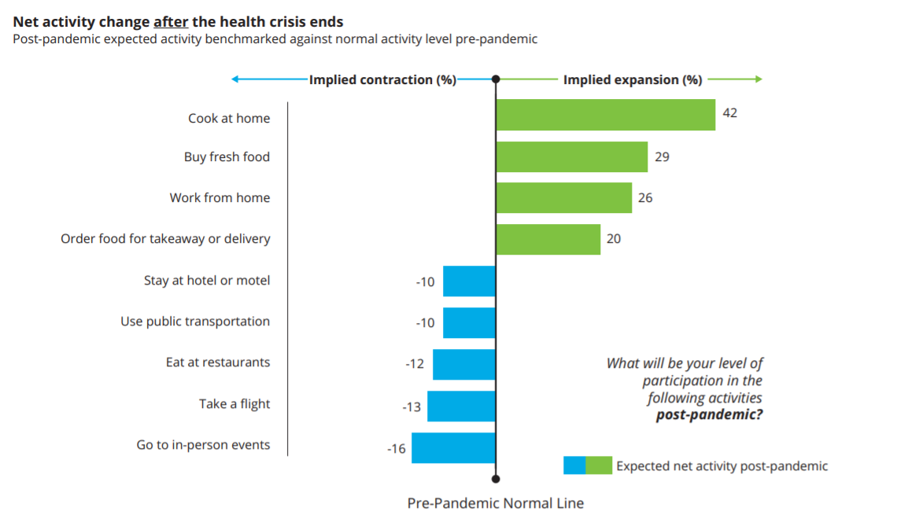
The pandemic altered purchasing behaviors and value drivers
Challenges
Altered purchasing
More consumers may be buying more food and cooking more at home than they did before the pandemic
54% of consumers found in-store shopping experience more stressful than last year
65% of consumers were at least sometimes unable to buy the food they wanted because it was out of stock
7 in 10 consumers think about food wastage when making purchases
Among ‘contemporary’ consumers, 64% were interested in food subscription services and 78% in low and no-prep fresh meal solutions
68% of contemporary consumers bought at least some food online versus only 10% of conventional consumers
Accelerated growing demand for fresh, healthy, additive-free food with traceable origins
Source: Surprise ingredients in the post-pandemic food story Consumers cooking up concern for restaurants’ return Barb Renner, Justin Cook, Steve Rogers.
17

Slide 18
Exporting to the US
18

Slide 19
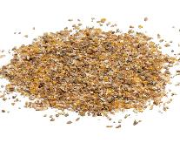






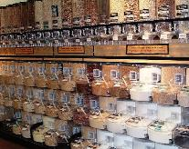
How do you prepare to export your product?
Exporting to the US
1
Know your product:
Determine 6-digit HS Code
Look at domestic sales
Examine unique or important features
Define competitor or substitute products
KNOW YOUR PRODUCT
2
Look at potential export markets:
Conduct market research
Decide on a pricing strategy
Define a strategy to find buyers
3
Develop an export plan:
Which countries, customer profiles, and marketing and distribution channels will you prioritize?
What food safety requirements must you meet?
  For example: ingredient, processing, product, labelling, packaging, intentional adulteration requirements
How will you promote your product?
  For example: websites, e-commerce platforms, trade shows, social media, among others
19

Slide 20
Which US agency manages imports?
Exporting to the US
Rationale
KEY REQUIRED PROVISIONS
TOOLS and RESOURCES
Proactive and strict enforcement of U.S. trade laws to protect national economic security, facilitate fair trade, support the health and safety of the American people, and ensure a level playing field for U.S. industry.
All products offered for entry into the United States, including items for personal use, must be declared to U.S. Customs and Border Protection (CBP).
CBP refers all FDA-regulated products to the FDA for review.
Introduction to the CBP Import Process | U.S. Customs and Border Protection
Centers of Excellence and Expertise | U.S. Customs and Border Protection (cbp.gov);
CEE@cbp.dhs.gov
Locate a Port of Entry | U.S. Customs and Border Protection (cbp.gov)
20

Slide 21
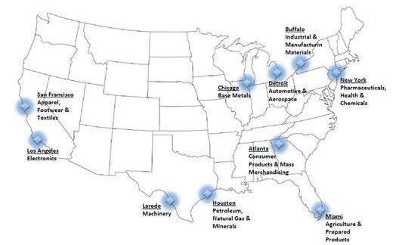
What is the US import process?
Exporting to the US
Entry Submission Process
Transmitting Required Information
Affirmation of Compliance Codes
Harmonized Tariff Schedule and FD Flags
Documents Required Status
Entry Review
Process
Complex set of forms needed at all stages from loading the conveyance to port entry
Includes establishment of a bond to guarantee payment of any tariffs, taxes and fees
Can be done by the owner of the goods, or by a designated customs broker or entry filer who assist the importer by submitting necessary entry information and appropriate payments to CBP on behalf of the importer.
Can use an importer to provide information to brokers/filers, are the only persons authorized by the U.S. to act as agents for importers.
21

Slide 22
Key Takeaways
22

Slide 23
Key Takeaways
Key Takeaways
Market Size & Growth
Segments & Competition
Trends & Opportunities
U.S. imports of agricultural products are expected to increase YoY while consumers increasingly demand non-traditional ingredients and products
Coconut products are expected to see the fastest growth, especially in coconut water
Jam, Jelly, and Preserves are expected to see flat to declining growth in a mature market
$141B in agricultural imports (2020)
  Most agricultural imports are within Western Hemisphere supply chains
Supermarket/hypermarket is main distribution channel for direct-to-consumer sales
Significant brand and label diversification with largely fragmented buying market
Innovation with flavors, structure, color, packaging, are continuous to meet consumer preferences
Shift to increasingly exotic and savory flavor profiles
Accelerated growing demand for fresh, healthy, additive-free food with traceable origins
More consumers may be buying more food and cooking more at home
23

Slide 24
Questions and Discussion
24

