Slide 1

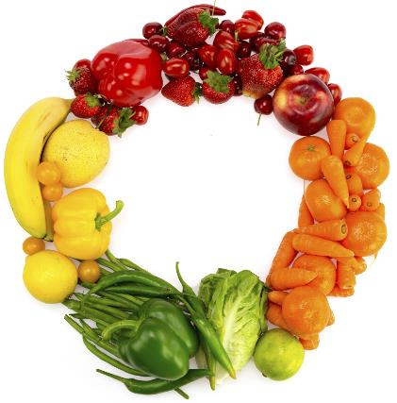

Understanding regulations and compliance requirements governing agro-food imports and sale in the US market
Deloitte Consulting LLP
October 27, 2021
Faye Feldstein

Slide 2


About the Presenter |
Introduction
  RELEVANT EXPERIENCE
  Faye J. Feldstein, M.S., has broad expertise in food safety, with over 38 years’ experience in the food processing industry and the U.S. Food and Drug Administration (FDA). Currently, she serves as a Senior Advisor to Deloitte Consulting LLP on issues of food safety management and regulatory compliance. Previously, she was the Director of the FDA’s Office of Food Defense and Emergency Response where she was engaged in the policy making related to traceability, recalls, epidemiology and bioinformatics, food defense and outbreak investigations. Faye also served as Vice President, Food Safety and Quality for at W.R. Grace and Co., Inc., producing a broad range of refrigerated and frozen food products. Her primary emphasis was regulatory affairs and regulatory compliance.
  Faye Feldstein
  Senior Advisor
  Food Safety
  Office: Washington D.C.
  Email: ffeldstein@deloitte.com
2

Slide 3

Agenda
Scope, Learning Objectives, and Marketscape
Regulatory Foundation – Food Safety
Regulatory Foundation – Imports Requirements
What Actions to Expect from FDA
Where to start
Questions and Discussion

Slide 4

Scope, Learning Objectives, and Marketscape
4

Slide 5
Scope of this Webinar…
Introduction
IS
An overview of the regulations and requirements for US Food and Drug Administration (FDA) food and food products to be exported to the United States
Inclusive of food safety and wholesomeness requirements AND an orientation to the general import requirements for all US FDA regulated foods
Aligned with NCE recommendations with a focus on tea, coconut products, spices and processed foods such as nuts, grains & cereals, canned food products (for example, jams, chutneys), beverages other than tea and confectionaries (for example, biscuits)
An informational framework to guide food producers and processors in navigating the complexity of the US imports process
IS NOT
A complete, detailed roadmap on how to specifically meet all food safety requirements for each type of commodity or food product exported to the US
A comprehensive, one size fits all guide to the imports process
5

Slide 6
Challenge and Learning Objectives
Introduction
  Challenge
  Objectives
Support agro-foods to become a more prominent export sector for Sri Lanka
Adapt as needed to technology and supply chain enhancements.
Ensure quality control and food safety compliance with accepted global standards
Gain access to market information and market intelligence
Demonstrate an understanding of the USFDA imports regulatory landscape
Describe some examples of the food safety/wholesomeness requirements for various foods/commodities
Explain the most relevant requirements for importing foods to the U.S.
Know how to find the resources for their specific products and import circumstances
6

Slide 7


Food safety as public health imperative
Introduction
1 in 6 Americans fall ill from foodborne pathogens annually
The Departments of Health and Human Services and Agriculture have joint authority for regulating food safety
Food and Drug Administration
Regulates:
Food (fresh, prepared, preserved, additives)
Drugs, medical devices, cosmetics, radiation-emitting products, vaccines, and veterinary products
United States Department of Agriculture
Regulates:
Meat Products (raw and prepared)
Poultry Products (raw and prepared)
Processed Egg Products
7

Slide 8
Regulatory Foundation
Food Safety
8

Slide 9
Guiding Principles: US Food and Drug Administration’s
Import Strategy for Food Safety
Regulatory Foundation
Government responsibility
  Protecting public health is the first priority
  Imported food must comply with same laws and regulations as food produced in the United States, including the food safety requirements, regardless of location along the supply chain
  Food must be safe and contain no prohibited ingredients
  Packaging must be informative and truthful, with the labeling information in English
Food industry responsibility
  Understand the hazards and issues around their product, their process, and the entire supply chain,
  Establish controls for those risks,
  Monitor those controls, and
  Establish a strong food safety culture as the key to food safety management – not just knowing the right thing to do, but doing it all the time, at all levels of the organization.
FDA executes this responsibility for food by validating the industry’s food safety program through a variety of oversight mechanisms.
9

Slide 10
UNDERSTAND THE FDA SYSTEM FOR RULES AND GUIDANCE
Regulatory Foundation
Rules
Code of Federal Regulations (CFR)
Food Drug and Cosmetic Act
Title 21 – Rules of the FDA
  Chapters and Parts (Examples)
  PART 117—Current Good Manufacturing Practice, Hazard Analysis, Aand Risk-Based Preventive Controls For Human Food
  Part 113—Thermally Processed Low-Acid Foods Packaged In Hermetically Sealed Containers
  Part 150—Fruit Butters, Jellies, Preserves, Aand Related Products
Sources: Electronic Code of Federal Regulations (eCFR) and OLRC Home (house.gov)
Guidance
Guidance Documents are published by the FDA on a regular basis as a methodology they use to communicate information about FDA processes and regulatory requirements in “plain language”. These are NOT binding Rules, but rather the FDA’s current thinking on a specific topic.
They are in various formats:
Step-by-step
Q&A
Interactive Tools and Databases
Educational and Training Videos
Lists of available guidance documents on any food related topic in searchable databases:
Guidance Documents & Regulatory Information by Topic (Food and Dietary Supplements) | FDA
FSMA Rules & Guidance for Industry | FDA
10

Slide 11
Food Safety Rules:
The Food Safety Regulatory Mandate
Regulatory Foundation
1
Prevention of food safety hazards
Food Safety Modernization Act of 2011
Most significant statutory change in food safety law and new FDA food safety authorities since 1938
Provided the FDA with an arsenal of new rules and authorities
This legislation shifts the Agency’s authority from reactive to proactive
Increases responsibility for the food industry and sets new standards for growers, food processors, manufacturers, and importers, among others
2
Detection of and response to food safety problems
3
Improving the safety of imported foods
11

Slide 12





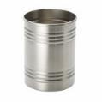




Food Safety Regulations: FSMA and More
Regulatory Foundation
A complex, diverse, overlapping and confusing set of food safety rules and requirements impacting your journey to export
FSMA Proposed Rule for Food Traceability
Hazard Analysis and Critical Control Point (HAACP) Procedures for the Safe and Sanitary Processing and Importing of Juice
Food Allergen Labeling and Consumer Protection (FALCPA) Act of 2004 AND Food Allergy Safety, Treatment, Education, and Research (FASTER) Act
The Nutrition Labeling and Education Act (NLEA)
Allergen Cross Contact Control
Preventive Controls for Human Food
Thermally Processed Low-Acid Foods Packaged in Hermetically Sealed Containers OR Acidified foods
FSMA Record Availability Requirements: Establishment, Maintenance, and Availability of Records
FSMA Proposed Rule on Laboratory Accreditation
FSMA Accredited Third-Party Certification
FSMA Sanitary Transportation of Human and Animal Food
FSMA Current Good Manufacturing Practice, Hazard Analysis, and Risk-Based Preventive Controls for Human Food
FSMA Mitigation Strategies to Protect Food Against Intentional Adulteration
1
2
3
4
5
6
7
A
12

Slide 13
FSMA Current Good Manufacturing Practice, Hazard Analysis, and Risk-Based Preventive Controls (CGMP & PC RULE) for Human Food
Regulatory Foundation
1
Example Products
KEY REQUIRED PROVISIONS
TOOLS and RESOURCES
Most tea
Coconut products
Spices & processed foods such as nuts, grains & cereals,
Confectionaries (biscuits).
Applies to most of the food products we are focusing on, but NOT all FDA regulated foods
Preventive Controls Qualified Individual (PCQI)
Development of a hazard analysis – what can go wrong here?
Written food safety plan – how and where can I control each the identified hazards?
Validation of adequacy of controls
Verification – vigilance in implementing the controls with records
INCLUDES: Process controls; sanitation controls; allergen controls and other controls
Draft Guidance for Industry: Hazard Analysis and Risk-Based Preventive Controls for Human Food | FDA
Food Safety Plan Builder | FDA
Key Facts about Preventive Controls for Human Food (fda.gov)
FSPCA Home | Institute for Food Safety and Health (IFSH) | Illinois Institute of Technology (iit.edu)
13

Slide 14










Allergen Cross Contact Control and Preventive Controls for Human Food
Regulatory Foundation
2
Example Products
KEY REQUIRED PROVISIONS
TOOLS and RESOURCES
9 Major Food Allergens:
Milk
Eggs
Fish
Shellfish
Tree nuts
Peanuts
Wheat
Soybeans
Sesame
Control for allergen CROSS-CONTACT in all phases of food supply chain
Receiving
Storage
Ingredient Prep
Equipment use, production schedule and product changeovers
Food Allergies | FDA
14

Slide 15

FSMA Mitigation Strategies to Protect Food Against Intentional Adulteration
Regulatory Foundation
3
Example Products
KEY REQUIRED PROVISIONS
TOOLS and RESOURCES
All Products
Preventing intentional adulteration from acts intended to cause wide-scale harm to public health, including acts of terrorism targeting the food supply.
Prepare and implement a food defense plan
Identify vulnerabilities and actionable process steps
Mitigation strategies
Procedures for food defense monitoring, corrective actions and verification
Reanalysis is required every three years or when certain criteria are met
Draft Guidance for Industry: Mitigation Strategies to Protect Food Against Intentional Adulteration | FDA
Food Defense Mitigation Strategies Database (fda.gov)
Food Related Emergency Exercise Bundle (FREE-B) | FDA
Intentional Adulteration Final Rule Video Presentation
Food Defense Plan Builder | FDA
Food Defense 101 - Front-line Employee | FDA
Employees FIRST | FDA
Who is covered?
Domestic and foreign companies that are required to register with the FDA
Primarily large companies; very small business has modified requirements
15

Slide 16

Requirements for Additional Traceability Records for Certain Foods
Regulatory Foundation
4
Example Products
KEY REQUIRED PROVISIONS
TOOLS and RESOURCES
Foods on the designated Food Traceability List | FDA; and those made with these products, not subjected to a kill step.
Purpose:
Rapidly and effectively identify recipients of certain foods to prevent or mitigate foodborne illness outbreaks by standardizing the data elements firms must establish and maintain, and send along the supply chain
Establish and maintain records containing Key Data Elements (KDEs) and Critical Tracking Events (CTEs)
  KDEs include location identifier, location description, entry number if imported, quantity and unit of measure, traceability lot codes
  CTEs include growing, receiving, transforming, creating, and shipping
Maintain records and make available to FDA within 24 hours of request in an electronic sortable spreadsheet
Proposed Rule: Requirements for Additional Traceability Records for Certain Foods (fda.gov)
Requirements for Additional Traceability Records for Certain Foods - Who is Subject to the Rule (fda.gov)
Proposed Rule: Requirements for Additional Traceability Records for Certain Foods - Key Terms Glossary (fda.gov)
Which Key Data Elements Would Apply to Me? | FDA
16

Slide 17
Thermally Processed Low-Acid Foods Packaged in Hermetically Sealed Containers OR Acidified foods
Regulatory Foundation
5
Example Products
KEY REQUIRED PROVISIONS
TOOLS and RESOURCES
Beverages
Other Canned Food Products like jams and chutneys
Definitions:
Low-acid canned food (LACF):
Any food in a thermally processed and hermetically sealed container with a finished equilibrium pH greater than 4.6 and a water activity greater than 0.85.
Acidified food (AF):
A low-acid food to which acid(s) or acid food(s) are added, and has a finished equilibrium pH of 4.6 or below and a water activity (aw) greater than 0.85 in a hermetically sealed container
Processing in commercial establishments with adequate and approved LACF equipment (e.g., steam retort system)
Thermal processes developed and validated under the supervision of a “process authority”
Processes must be filed with FDA for each product, product style, container size and type and processing method
Overlapping Regulations:
These LACF/AF rules address microbiological hazard control only
The FSMA Preventive Controls rule applies for all other controls: for chemical and physical hazard control; sanitation, allergens, GMPs
Acidified & Low-Acid Canned Foods Guidance Documents & Regulatory Information | FDA
Establishment Registration & Process Filing for Acidified and Low-Acid Canned Foods (LACF) | FDA
Guidance for Industry: Low-Acid Foods Packaged in Hermetically Sealed Containers (LACF) Regulation and the FDA Food Safety Modernization Act | FDA
Establishment Registration and Process Filing for Acidified and Low-Acid Canned Foods (LACF): Electronic Submissions | FDA
17

Slide 18
Hazard Analysis and Critical Control Point (HAACP) Procedures for the Safe and Sanitary Processing and Importing of Juice
Regulatory Foundation
6
Example Products
KEY REQUIRED PROVISIONS
TOOLS and RESOURCES
Fruit and Vegetable Beverages and Purees
Description of Products Covered:
“Juice” is the aqueous liquid expressed or extracted from one or more fruits or vegetables, purees of the edible portions of one or more fruits or vegetables, or any blends and/or concentrates of such liquid or puree, sold as 100% juice.
Hazard analysis
Control measures and performance standards
Monitoring
Record keeping
Overlapping Regulations:
Juice processors still must meet FSMA PC subparts A, B, and F (GMPs, records and training)
If LACF or Acidified products, then certain provisions of juice HACCP are not required
Federal Register: Hazard Analysis and Critical Control Point (HAACP); Procedures for the Safe and Sanitary Processing and Importing of Juice
Guidance for Industry: Juice Hazard Analysis Critical Control Point Hazards and Controls Guidance, First Edition | FDA
Guidance for Industry: Juice HACCP and the FDA Food Safety Modernization Act | FDA
18

Slide 19

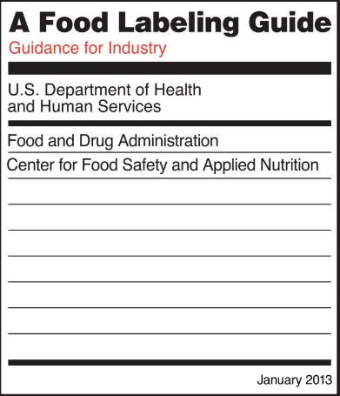
Labelling for Retail
Regulatory Foundation
7
KEY REQUIRED PROVISIONS
Example Products
TOOLS and RESOURCES
Comprehensive food labeling is required for most prepared foods, such as breads, cereals, canned and frozen foods, snacks, desserts, drinks, etc.
All products for import must meet US requirements. Some examples include:
  Name of Food
  Ingredient Declaration
  Allergen statement
  Nutrition Facts Panel
  Claims, If applicable: Nutrient Content, Gluten Free, Health
  Net Quantity
  Colors
  Country of Origin statement
  Name and address of the manufacturer, packer or distributor
All products for packaged for retail sale
Food Labeling Guide (fda.gov)
Relevant Regulations
Federal Food, Drug, and Cosmetic Act (FFD&C Act)
Fair Packaging and Labeling Act
Nutrition Labeling and Education Act
FDA’s regulations on food labeling - 21 CFR 101
The Nutrition Labeling and Education Act (NLEA)
Food Allergen Labeling and Consumer Protection (FALCPA) Act of 2004 AND
Food Allergy Safety, Treatment, Education, and Research (FASTER) Act of 2021
19

Slide 20

Specific Technical Assistance on FDA Food Safety Rules
Regulatory Foundation
FSMA Technical Assistance Network (TAN) | FDA
FSPCA Technical Assistance Network
Food Safety Preventive Controls Alliance (FSPCA)
Institute for Food Safety and Health (IFSH)
Illinois Institute of Technology (iit.edu)
Submit Your Question Electronically or via mail
Answered by FDA Information Specialists or Subject Matter Experts
FDA will respond to inquiries received as soon as possible.
Receive notification of receipt and a case number to be referenced in future correspondence.
TO BE USED FOR QUESTIONS ON INTERPRETING REGULATIONS
Providing technical assistance to industry, academia and others on FDA’s Preventive Controls human food regulations.
Submit Your Question Electronically or via mail
TO BE USED FOR QUESTIONS ON IMPLEMENTING THE REGULATIONS
TOOLS and RESOURCES
FSMA Technical Assistance Network (TAN) | FDA
FSPCA Technical Assistance Network | Food Safety Preventive Controls Alliance (FSPCA) | Institute for Food Safety and Health (IFSH) | Illinois Institute of Technology (iit.edu)
20

Slide 21
Regulatory Foundation
Import Requirements
21

Slide 22
Guiding Principles: US Strategy for Food Imports
Regulatory Foundation
1
2
3
4
Pre-Approval
Prevention
Response
Transparency and Communication
Foods can be imported into the United States without prior sanction by FDA, as long as they meet all legal requirements.
Food offered for import meets U.S. food safety requirements
Sustaining a level playing field for domestic and foreign food producers
Allocating resources according to risk
FDA border surveillance prevents entry of unsafe foods
Rapid and Effective Response to Unsafe Imported Food
Effective and Efficient Food Import Program
Partnering with others to build prevention‐based systems
TOOLS and RESOURCES
FDA Strategy for the Safety of Imported Food
How to Start a Food Business | FDA
Importing Food Products into the United States | FDA
Office of Global Policy and Strategy | FDA
22

Slide 23
Overview of Imports Regulations
Regulatory Foundation
A complex, diverse, overlapping and confusing set of rules and requirements impacting your journey to export
Public Health Security and Bioterrorism Preparedness and Response Act of 2002
FSMA Final Rule on Foreign Supplier Verification Programs (FSVP) for Importers of Food for Humans and Animals | FDA
1
2
23

Slide 24
Public Health Security and Bioterrorism Preparedness and Response Act of 2002 – Food Facility Registration
Regulatory Foundation
Rationale
KEY REQUIRED PROVISIONS
TOOLS and RESOURCES
To help FDA determine the location and source of a potential bioterrorism incident or an outbreak of food- borne illness; and quickly notify facilities that may be affected.
Updated Regulation:
Updated in Food Safety Modernization Act of 2011
Must register: Owner, operator, or agent in charge of either a domestic or foreign facility engaged in manufacturing/processing, packing, or holding of food for consumption in the United States.
"Facility" is any establishment, structure or structures at one general physical location
If business has more than one location, your U.S. Agent must get a registration number for each location.
US Agent: Foreign facilities must designate a U.S. agent, who is physically present in the United States, available 24/7, knowledgeable in FDA food rules, for purposes of communication between the facility and FDA. The U.S. agent also may be authorized to register the facility.
New registration: when starting a new business or another facility of an existing business
Update registration when any changes in information
Biennial renewal required, even if no changes
Online Registration of Food Facilities | FDA
Food Facility Registration User Guide: Step-by-Step Instructions | FDA
Food Facility Registration User Guide: Biennial Registration Renewal | FDA
Food Facility Registration User Guide: Update Registration | FDA
Guidance for Industry: Questions and Answers Regarding Food Facility Registration (Seventh Edition) | FDA
U.S. Agents | FDA
24

Slide 25
Public Health Security and Bioterrorism Preparedness and Response Act of 2002 – Prior Notice
Regulatory Foundation
Rationale
KEY REQUIRED PROVISIONS
TOOLS and RESOURCES
For FDA to evaluate information before a food product arrives, inspect & intercept contaminated food
Updated Regulation:
Updated in Food Safety Modernization Act of 2011
FDA must be notified in advance of any shipments of imported food, even if the item is intended for further processing, is not for consumption in the U.S., or is not for commercial distribution
Prior Notice must be submitted electronically through either CBP's Automated Broker Interface of the Automated Commercial System (ABI/ACS) OR the FDA Prior Notice System Interface (PNSI)
Any individual with knowledge of the required information can submit Prior Notice, may be the importer
Prior notice must be submitted, and confirmed by FDA no less than:
  4 hours before arrival, if the food is arriving by air; and
  8 hours before arrival, if the food is arriving by water
Information must be in English, except an individual’s name, company name, and the street name
Examples of information: Commodity & subtype; Product code; Product description; Country code (where product was produced, sourced, grown, or harvested); Contact info for manufacturer, shipper, importer, delivered to party
Guidance for Industry: What You Need to Know About Prior Notice of Imported Food Shipments | FDA
Quick Start Guide for Prior Notice for Food Articles in the Prior Notice System Interface (PNSI) | FDA
Step-by-Step Instructions for Prior Notice for Food Articles in the Prior Notice System Interface (PNSI) | FDA
Information Required in Prior Notice of Imported Food
Prior Notice System Interface (PNSI) Product Code Builder Tutorial | FDA
U.S. Customs and Border Protection ACE Login (dhs.gov)
Prior Notice System Interface
PN Q&A: download (fda.gov)
FDA ACE Affirmations of Compliance Quick Reference
25

Slide 26
FSMA Foreign Supplier Verification Program
Regulatory Foundation
Rationale
Importers are required To
TOOLS and RESOURCES
Importers are accountable for ensuring their products meet the same safety standards as domestic products.
  Determine known or reasonably foreseeable hazards with each food
  Evaluate the risk posed by a food, based on the hazard analysis, and the foreign supplier’s performance
  Develop, maintain, and follow an FSVP for each food and each foreign supplier of that food.
  Determine appropriate verification activities, based on risk of the food & supplier’s performance, including:
      Annual on-site audits
      Sampling and testing
      Review of the supplier’s relevant food safety records
  Can rely on another entity to determine and perform appropriate supplier verification activities (Third Party Rule)
  Conduct corrective actions
  Importers that are also manufacturers/ processors are deemed in compliance with most FSVP requirements.
  Most importers choose to hire licensed customs brokers or entry filers. The entry filers can assist the importer by submitting necessary entry information and appropriate payments to CBP on behalf of the importer.
What Do Importers Need to Know About FSVP | FDA
Am I subject to FSVP? (fda.gov)
Final Rule on Foreign Supplier Verification Programs (fda.gov)
KEY REQUIREMENTS: Final Rule on Foreign Supplier Verification Programs (fda.gov)
Draft Guidance for Industry: Foreign Supplier Verification Programs for Importers of Food for Humans and Animals | FDA
KEY REQUIRED PROVISIONS
Applies to foreign suppliers of products subject to the PC for Human Food Rule
FSVP “importer” is the U.S. owner or consignee of the food offered for import, and must be in the US
Does not apply to Juice HACCP OR LACF/AF requirements ….for microbiological hazards only
26

Slide 27
Regulatory Foundation
What Actions to Expect from the FDA
27

Slide 28
Entry Review & Inspections of Foreign Food Facilities
Regulatory Foundation
1
2
Entry Review
Inspections
Actions at Entry
Results at Entry
International FDA inspections
Results of Inspection
All imported shipments are reviewed by FDA
Use electronic risk prioritization tools like PREDICT
  incomplete or inaccurate data
  Products examination or sampling,
Further reviews by FDA entry reviewers
Release the product
Request additional information,
  Review of entry documents
  Examination/sample collection
Detention & Hearing if threat of serious adverse health consequences or death
Import Alerts
Import Refusals
Filer Evaluations
Identify potential food safety problems and support admissibility decisions at entry
Select facilities for inspection based on risk
  type of food
  the manufacturing process, and
  the compliance history of the facility,
Prior notification to facility
business as usual;
import alert;
increasing sampling and/or examination;
refusal of admission;
If refuse inspection, FDA to refuse admission; failure to respond to FDA’s notice of intent is refusal
TOOLS and RESOURCES
Entry Review | FDA
Entry Screening Systems and Tools | FDA
PREDICT OVERVIEW (fda.gov)
Actions & Enforcement | FDA
Foreign Food Facility Inspection Program | FDA
Foreign Food Facility Inspection Program Questions & Answers | FDA
Draft Guidance for Industry: Refusal of Inspection by a Foreign Food Establishment or Foreign Government (fda.gov)
28

Slide 29
Prior Notice and Registration Penalties
Regulatory Foundation
Prior Notice Filings
Food Facility Registration
Possible Penalties
Possible results if fail to file:
Refusal for no prior notice, inaccurate prior notice, or untimely prior notice
Injunction
Prosecution
Debarment
Seizure
Assessment of Civil Monetary Penalties
Possible results if fail to register, renew or update:
Hold food at port of entry
Cancel registration if not renewed or updated
Civil injunction proceedings
Criminal penalties, and
Debarment of a person who has been convicted of a felony related to the importation of food into the U.S.
Release the product for entry
Review documents
collect samples for lab analysis
Import Alert
Increased sampling
Refusal of admission
Injunction
Prosecution
Debarment
Seizure
Assessment of Civil Monetary Penalties
Cancel registration
Criminal Penalties
Detention & Hearing
Filer Evaluations
29

Slide 30
Regulatory Foundation
Where to Start?
30

Slide 31
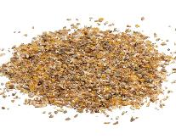








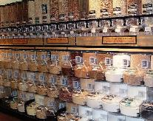
How do I find the correct food safety rules that apply to my company and my product?
Regulatory Foundation
1
Know the ingredients and characteristics of your product, process, and packaging
KNOW YOUR PRODUCT
Understand that you may need to comply with certain sections of several different rules
2
3
Recognize that you may need food safety rules for:
General food safety requirements such as transportation, recordkeeping, supply chain information
Specific ingredient, processing and product requirements
Labelling requirements,
Packaging requirements
Intentional adulteration requirements
31

Slide 32

How do I navigate the complex process to export to the US
Regulatory Foundation
1. Review the information and use the resources available to you!
2. Register Your Facility(ies) with the U.S. Food and Drug Administration
3. Designate a U.S. Agent to handle your U.S. Communications.
5. Apply the FDA Food Safety Requirements for Your Food Product
6. Align with the Importer, Customs Broker, etc. to export the product
4. Obtain all Required Entry Filings and Permits (CBP)
The Import process is managed by the Department of Homeland Security through the Customs and Border Protection Agency (CBP). For food products, CBP and FDA collaborate.
32

Slide 33
Regulatory Foundation
Questions and Discussion
33

Slide 35
Appendix
35

Slide 36
Marketscape of Food Imports to the US
Introduction
Statistics
US consumers expect
Impact
Leading to...
The United States imports…
15 percent of its overall food supply
From more than 200 countries or territories
From approximately 125,000 exporting food facilities and farms
Resulting in 14 to 15 million shipments of imported food in 2019
Variety
Food Safety
Quality
Convenience
Availability
Affordability
Increased volume of imported foods
Increased globalization of the food supply
Impact of climatic differences
Potential for increase in economic fraud and intentional adulteration
Many different international food safety standards and regulatory capacities
Potential for new hazards or known hazards in different foods
More complex food chains
Technological advances
Varying business models
Increased specialization
Increased collaboration
Therefore, creating a need for FDA to modernize their food safety program
Source: USDA ERS - U.S. Food Imports
36

Slide 37
Department of Homeland Security: Customs and Border Protection (CBP) (1 of 2)
Regulatory Foundation
Rationale
KEY REQUIRED PROVISIONS
TOOLS and RESOURCES
Proactive and strict enforcement of U.S. trade laws to protect national economic security, facilitate fair trade, support the health and safety of the American people, and ensure a level playing field for U.S. industry.
All products offered for entry into the United States, including items for personal use, must be declared to U.S. Customs and Border Protection (CBP).
CBP refers all FDA-regulated products to the FDA for review.
Introduction to the CBP Import Process | U.S. Customs and Border Protection
Centers of Excellence and Expertise | U.S. Customs and Border Protection (cbp.gov);
CEE@cbp.dhs.gov
Locate a Port of Entry | U.S. Customs and Border Protection (cbp.gov)
37

Slide 38
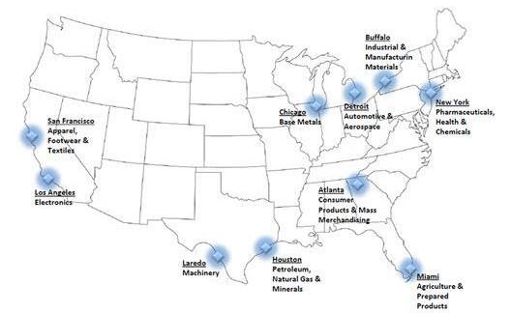
Department of Homeland Security: CBP (2 of 2)
Regulatory Foundation
Entry Submission Process
Transmitting Required Information
Affirmation of Compliance Codes
Harmonized Tariff Schedule and FD Flags
Documents Required Status
Entry Review
Process
Complex set of forms needed at all stages from loading the conveyance to port entry
Includes establishment of a bond to guarantee payment of any tariffs, taxes and fees
Can be done by the owner of the goods, or by a designated customs broker or entry filer who assist the importer by submitting necessary entry information and appropriate payments to CBP on behalf of the importer.
Can use an importer to provide information to brokers/filers, are the only persons authorized by the U.S. to act as agents for importers.
38

Slide 39
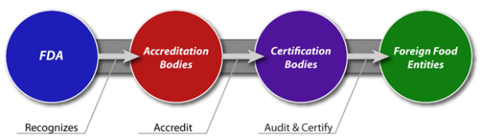
Other Relevant FSMA Rules
Regulatory Foundation
Accredited Third-Party Certification
Proposed Rule on Laboratory Accreditation
Record Availability Requirements
FDA can access records:
beyond records relating to the specific suspect article of food
to records relating to any other article of food that is likely to be affected in a similar manner.
if FDA believes that there is a reasonable probability that the use of or exposure to articles of food, that will cause serious adverse health consequences or death to humans or animals.
  Voluntary program in which FDA recognizes “accreditation bodies”
  Responsible for accrediting third-party “certification bodies.”
  Certification bodies will conduct food safety audits and issue certifications of foreign food facilities.
Proposing a program for the testing of food by accredited laboratories
Requires that the testing of food in certain circumstances is done by laboratories that voluntarily become accredited
Results could be used:
  to support the admissibility of imported food into U.S. commerce;
  to address an import alert through successful consecutive testing;
Results of the food testing, under this program, required to be sent directly to the FDA
TOOLS and RESOURCES
Guidance for Industry (fda.gov)
Accredited Third-Party Certification Program | FDA
FDA Dashboards - Accredited Third-Party Certification Program
FSMA Proposed Rule on Laboratory Accreditation | FDA
39

Slide 40
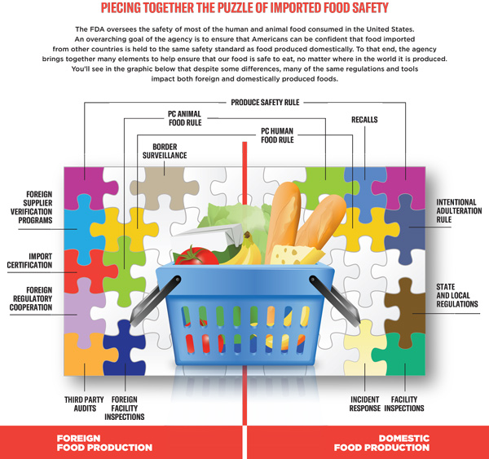
PIECING TOGETHER THE PUZZLE OF IMPORTED FOOD SAFETY
Regulatory Foundation
Source: FDA Strategy for the Safety of Imported Food | FDA
40

Slide 41
Key Examples of the Food Safety Rules: Transportation
FSMA Sanitary Transportation of Human and Animal Food
Example Products: All Products
Who is covered:
Shippers who ship food to the US directly by motor or rail vehicle, or by ship or air, and
arrange for the transfer of the intact container onto a motor or rail vehicle for transportation within the U.S.,
if that food will be consumed or distributed in the United States.
KEY PROVISIONS:
1. Vehicles and transportation equipment:
suitable and adequately cleanable for their intended use
capable of maintaining temperatures necessary for the safe transport of food.
2. Transportation operations:
adequate temperature controls,
preventing contamination of ready to eat food from touching raw food,
protection of food from contamination by non-food items in the same load or previous load, and
protection of food from allergen cross-contact.
3. Training:
Mandatory training of carrier personnel in sanitary transportation practices
documentation of the training
4. Records:
Maintenance of records of written procedures, agreements and training.
TOOLS AND RESOURCES
Training for Carriers covered by the Sanitary Transportation of Human and Animal Food Rule | FDA
Final Rule on Sanitary Transportation of Human and Animal Food (fda.gov)
41

